Slide 1
Project Red Talon
Preventing STDs and HIV among Tribes in
Oregon, Washington, and Idaho.
Northwest Portland Area
Indian Health Board

Slide 2
Northwest Portland Area Indian Health Board
Established in 1972, the Board is a non-profit tribal organization serving the 43 federally recognized
tribes of Oregon, Washington, and Idaho.
Indian Leadership for Indian Health

Slide 3
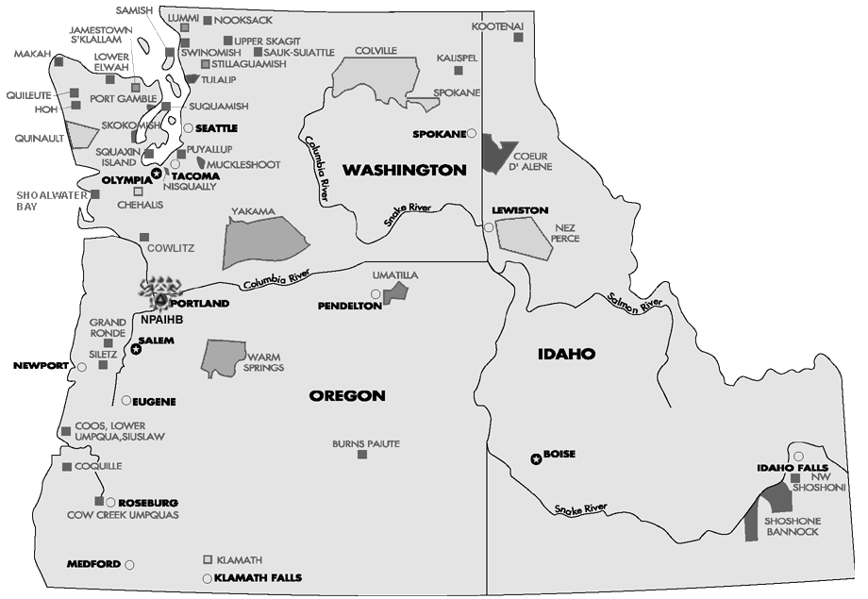
MISSION:
To assist Northwest tribes
to improve the health status and quality of life of member tribes and
Indian people in their delivery of culturally appropriate and
holistic health care.

Slide 4


Slide 5




Project Red Talon: Four Objectives
Increase Capacity to Prevent STDs
Increase Awareness about STDs
Improve AI/AN Representation
Improve Testing & Treatment

Slide 6
What’s your favorite STD?
Chlamydia
Gonorrhea
Syphilis
Herpes
HIV/AIDS
Human Papillma Virus (HPV)

Slide 7
Which STD is most common?
Chlamydia
Gonorrhea
Syphilis
HIV/AIDS

Slide 8
Cases per 100,000

Slide 9
What percentage of new HIV diagnoses are among young people age 29 and under?
10%
25%
50%
75%

Slide 10
New AI/AN HIV Diagnoses - 2005

Slide 11
STD: Transmission
Skin-to-Skin Contact
Sexual Fluids
Ingest Fecal Material

Slide 12

Copyright © 2001-2004 Campaign for Our Children

Slide 13
Among women, what percentage of chlamydia infections cause no signs or symptoms?
10%
25%
50%
75%

Slide 14
Most Infections are Silent!
Most STDs do not produce noticeable signs or symptoms.
75% of women and 50% of men with chlamydia have no signs or symptoms.

Slide 15
NW Rates: Youth Impact
In the Northwest, over 800 Native youths age 10-24 years were diagnosed with chlamydia in 2005.

Slide 16
Are STDs Serious?
Yes. STDs are the most preventable cause of infertility in the U.S.
Without treatment, chlamydia and gonorrhea can cause permanent damage to the reproductive organs.

Slide 17


Slide 18
Project Red Talon
What’s New?

Slide 19




Research Questions
Quantify media technology use among AI/AN youth
Describe patterns of health information-seeking among AI/AN youth
Develop priorities for designing culturally-appropriate media interventions
Evaluate existing media interventions in relation to survey findings

Slide 20



Methods
Survey over 400 AI/AN teens and young adults in Oregon, Washington and Idaho
Systematic Literature Review
Community-Based Participatory Research

Slide 21
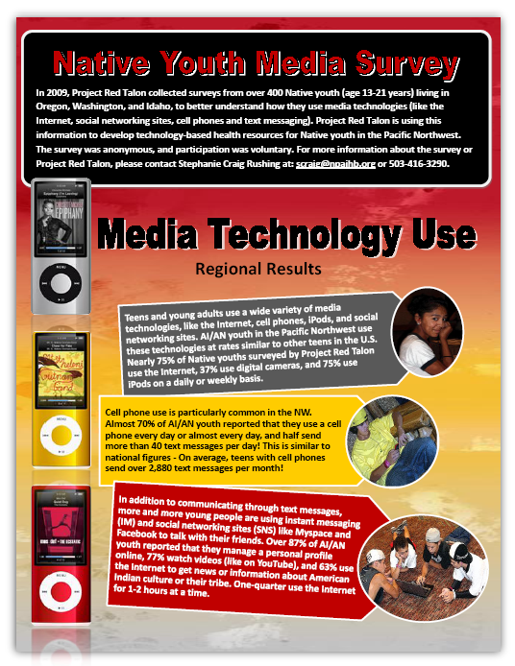
Notes:
Visit www.NetSmartz.org

Slide 22
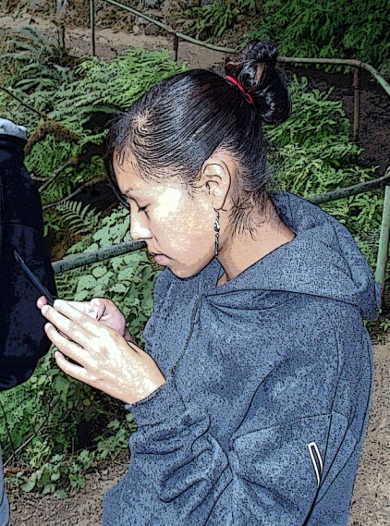
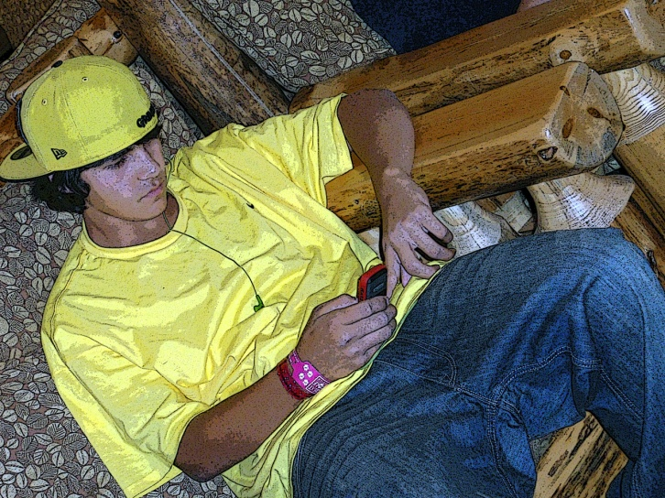
Sexting (a combination of sex and texting) is the act of sending sexually explicit messages or photos electronically, primarily between cell phones.
Notes:
In 2007, 32 Australian teenagers from the state of Victoria were prosecuted as a result of sexting activity.^{[8]}
Child pornography charges were brought against six teenagers in Greensburg, Pennsylvania in January 2009 after three girls sent sexually explicit photographs to three male classmates.^{[9]}
In 2008, a Virginia assistant-principal was charged with possession of child pornography and related crimes after he had been asked to investigate a rumored sexting incident at the high school where he worked. Upon finding a student in possession of a photo on his phone that depicted the torso of a girl wearing only underpants, her arms mostly covering her breasts, the assistant principal showed the image to the principal who instructed him to preserve the photo on his computer as evidence, which he did. While the court later ruled that the photo did not constitute child pornography because under Virginia law, nudity alone is not enough to qualify an image as child pornography; the image must be "sexually explicit" and "lewd." Loudoun County prosecutor James Plowman stands by his initial assessment of the photo and says he would not have pursued the case if the assistant principal would have agreed to resign. The assistant principal had to get a second mortgage on his house and spend $150,000 in attorneys' fees to clear his name.^{[10][11]}
In Fort Wayne, Indiana, a teenage boy was indicted on felony obscenity charges for allegedly sending a photo of his genitals to several female classmates. Another boy was charged with child pornography in a similar case.^{[12]}
Police investigated an incident at Margaretta High School in Castalia, Ohio in which a 17-year-old area girl allegedly sent nude pictures of herself to her former boyfriend, and the pictures started circulating around the high school after the two got into a fight.^{[13]} The 17-year-old girl was charged with being an "unruly child" based on her juvenile status.^{[14]}
Two southwest Ohio teenagers were charged with contributing to the delinquency of a minor, a first-degree misdemeanor, for sending or possessing nude photos on their cell phones of two 15-year-old classmates.^{[15]}
The American Civil Liberties Union of Pennsylvania filed a lawsuit against Wyoming County district attorney George Skumanick Jr. on March 25, 2009 for threatening to prosecute teenage girls for distributing nude photos of themselves.^{[16]} The case is^{[17]} Miller, et al v. Skumanick. On CBS News's The Early Show, Skumanick stated in an interview with Julie Chen that his office decided to make an offer of limiting penalties to probation if they attend a sexual harassment program.^{[18][19]}
Legislative responses
Vermont lawmakers introduced a bill in April 2009 to legalize the consensual exchange of graphic images between two people 13 to 18 years old. Passing along such images to others would remain a crime.^{[20]}
In Ohio, a county prosecutor and two lawmakers proposed a law that would reduce sexting from a felony to a first degree misdemeanor, and eliminate the possibility of a teenage offender being labeled a sex offender for years. The proposal was supported by the parents of Jessie Logan, a Cincinnati 18-year-old who committed suicide after the naked picture of herself which she sexted was forwarded to people in her high school.^{[21]}
Utah lawmakers lessened the penalty for sexting for someone younger than 18 to a misdemeanor from a felony.^{[22]}

Slide 23

Notes:
Sexting' can be considered child pornography
Story Updated: Mar 15, 2009 at 1:15 PM PDT
By Anna Song KATU News
VANCOUVER, Wash. - A recent sexting incident at Mountain View High School in Vancouver, Wash., involved a girl taking pictures of herself and texting them to others.
The principal told KATU the mishap was contained to a small group of kids. But students familiar with the situation said the pictures made it school-wide. And they said it isn’t anything new.
One student said the pictures usually go around the school and the person involved gets made fun of for a week or two and then it all usually dies down.
Another student told KATU he forwarded the text to others and was brought into the school office for a chat with administrators. He only received a warning but was told he would get into trouble if it happened again.
Criminal charges possible
But here’s the reality: Teenagers can be charged with child pornography for sexting. It is happening all across the country to kids as young as 13.
“You’re talking about your lives, your futures,” said Jason Gershuny, a health teacher at LEP High School in Portland, a public charter school. “If you take a picture of yourself naked and send it to a friend, not only is that person who is getting that picture now in possession of child pornography, but you just created some yourself.”
Gershuny said the possibility of being charged with a crime for sexting took his students by surprise.
“They just had no idea,” he said. “And I think some of them were like ‘Wait, even in my phone?’ It sort of like struck a chord with … some students who may have been like, 'I might need to do something about this.' "
Teen advocates who talked to Gershuny’s class about dating violence said they have been hearing all kinds of horror stories from students.
In one case, a girl was at a party and was changing in a bathroom when some guys threw the door open and used their cell phones to take a picture of her, said Lauren Paulk, a teen advocate with Volunteers of America. They then spread that picture to the rest of the school.
“And the girl actually ended up dropping out, and the guys were never punished for the incident,” Paulk said.
Girl commits suicide over photo
Last year, Jesse Logan, an 18-year-old from Ohio, hanged herself after her ex-boyfriend reportedly spread nude photos of her around. She had sent the pictures to him while they were dating.
“Kids need to understand that what is seemingly a harmless prank can be extremely dangerous,” said Tom Cleary, a Multnomah County senior deputy district attorney who heads up the county’s juvenile department.
He is confidant that it is just a matter of time before his office receives a sexting case that warrants charges against a teen.
“They shouldn’t feel that just because they’re juveniles they’re immune from criminal prosecution,” he said.

Slide 24

Notes:
'Sexting' in Newport: Dumb prank or child porn? by Lori Tobias, The Oregonian Saturday March 28, 2009, 4:20 PM
NEWPORT -- To some, it might seem like a dumb teenage prank. To others, it's child pornography worthy of criminal prosecution.
Either way, a 17-year-old Oregon girl faces years in prison after using her cell phone at a drunken party in Newport last year to record, for a minute or less, a 16-year-old girl involved in crude sexual activity.
The case is an Oregon example of "sexting" -- a rapidly growing trend in which teens share revealing images of themselves or others via cell phone. Across the U.S., teens who've sent or received such images have found themselves charged with crimes such as distribution or possession of child pornography.
Critics say sex-crime laws were never meant to apply to teenage girls sending naughty photos of themselves to boyfriends, for example. But others say it's not that clear-cut, especially in the Oregon case.
"This is a relatively new activity and is not a matter of settled law," said Bill Albert, spokesman for the National Campaign to Prevent Teen and Unplanned Pregnancy in Washington, D.C. "A lot of law enforcement agencies are scratching their heads and saying, 'What should we do? What is our role to play?' If you do a quick Google search for sexting, you will come up with dozens of criminal cases."
In a survey his group conducted last December, one-fifth of teens and one-third of adults ages 20 to 26 admitted sending or posting nude or partly nude images of themselves. And because people lie to pollsters, he said, he figures the real number is higher.
Why would teens do such a thing? "Three-quarters of them described it as a fun and flirtatious activity," Albert said. "What is clear in Technicolor is that what is considered public behavior and what is private is a very blurry line for a lot of young people these days."
By all accounts, the Newport incident was more egregious than most.
At least one adult and a crowd of teens, including a girl who is now 17, gathered at a vacation rental home last April for a night of partying. The Oregonian is not identifying the girl because she is a juvenile.
According to the account in court documents, the girl, 16 at the time, told police that everyone was drinking. She was in a bedroom with another girl, a 16-year-old friend, who was drunk and partly naked. A man in the room, 30-year-old David Michael Guy Simpson, encouraged his dog to have oral contact with the friend.
"I thought this was funny so I recorded it on my cell phone," the girl told Newport police Detective Ken Real, according to the documents.
A few days later, the girl showed the clip, which lasted from 45 seconds to one minute, to Jesse Duane Carey, then 18. He, in turn, sent it to his own cell phone, the documents say.
Authorities wouldn't say whether Carey shared the video or how police found out about it. But in February, warrants were issued for the arrests of the girl who shot the video and for Simpson and Carey. Now the girl and Simpson have been charged with Measure 11 crimes that carry mandatory sentences of years in prison. If convicted, they could also be required to register as sex offenders.
The girl, arrested March 3 and released to an aunt and uncle March 11, faces one count of sexual abuse and one count of using a child in a display of sexually explicit conduct -- felonies that respectively carry mandatory minimum sentences of 75 to 70 months (about six years) in prison. She also is charged with two counts of encouraging sexual abuse, another felony.
Simpson, arrested Feb. 17 and still in the Lincoln County Jail, faces two counts of sex abuse and one count of using a child in a sexual display. Carey, arrested and released in February, has been charged with three counts of encouraging child sex abuse.
Unsettled home life
The girl's life hasn't been easy, said Colleen Ritz, who took the teen into her home after her daughter befriended the girl and said she had nowhere to live. The girl "was on her way to Portland to live with her dad's ex-girlfriend because she said she wasn't going to live with her dad," Ritz said. "We told her, 'Just come stay with us.' She's had a bad rap in life."
A teen who was at the party also defended the girl. The teen, whose mother asked that she not be identified, said 20 to 30 teens had gathered just wanting to have fun. She said the girl would not have recorded the goings-on to be mean.
"She's not that kind of person," the teen said. "I think she thought, 'This is funny; we're drunk. Look at what she is doing.' They used to be good friends."
Paul Ferder, Simpson's attorney, said the charges in this case are probably excessive. The attorney for the girl was on vacation and could not be reached, and Carey's attorney did not return a phone call.
Monday court date
The girl and Simpson are due in court Monday for an early-resolution conference with their attorneys and Lincoln County Circuit Judge Charles Littlehales.
"Normally, that's the time to tell the court whether you need a trial or if it's been resolved," said Mike Flinn, Benton County deputy district attorney, who's prosecuting the case because Carey is the son of a Lincoln County sheriff's deputy. "We could negotiate lesser charges, but I can't say if that's going to happen."
Littlehales this month did reduce bail for the girl from $350,000 to $50,000, and for Simpson from $350,000 to $150,000.
"If you have a person who has not committed extreme criminal violence but is still subject to Measure 11, shouldn't the court have discretion?" he said in an interview last week. "There are a lot of young people doing things, and they don't recognize the seriousness of what charges can and will be brought. It's kind of frightening that, one, they do it and, two, the consequences it may bring."
He also expressed concern for the girl's predicament. "It would be life-changing if she gets the minimum. ... That's pretty severe for a 17-year-old."
Albert, the spokesman in Washington, D.C., also cited the girl's age as cause for ambivalence.
"Should a 16-year-old face time in jail and be labeled a sex offender when it is minor to minor? That's a very tough call," he said. "I think we all feel quite differently when an adult is involved."
But John Shehan, spokesman for the National Center for Missing & Exploited Children in Alexandria, Va., said this case isn't sexting, it's child pornography.
"These are crime-scene photographs, certainly," he said. "Not only is it pornography of children but possible bestiality. If these images are leaked to the masses, they will be forever memorialized and traded. There are individuals who collect these, and they become highly coveted. It has a lifetime of repercussions."
-- Lori Tobias; loritobias@news.oregonian.com

Slide 25

Notes:
Sexting Hits Nampa High
Posted: May 18, 2009 06:37 PM
Nampa, Idaho -- A Nampa teen could face serious charges after taking nude pictures of herself and sending them via text.
Those pictures have made the rounds being forwarded on to several students at Nampa High School.
"There's a picture of a girl exposing her breasts," said Joy Egan a freshman at Nampa High School who saw the picture.
"I've seen it like more than 10 times probably," said Izzy Rodriguez, a Nampa High freshman, "After it and stuff, she felt horrible."
According to these Nampa High students, the girl who took the picture is only a freshman and the picture was meant for her boyfriend.
Unfortunately, this is becoming a pretty common occurrence. There's even a name for it -- "sexting." It's the act of taking sexually explicit pictures and sending them electronically.
"I guess I'm flabbergasted that anyone would take a photo of themselves without clothing on and send it to someone and not think that was going to backfire on you," said Nampa Police Chief Bill Augsburger.
Those photos have caught the attention of Nampa Police who are proceeding slowly to make sure the case is handled right.
"It is kind of a new thing. It's not unheard of, but it's new to us," said Augsburger.
Possible charges include phone harassment and disseminating child porn. The number of students prosecuted for this is also a big question mark. In other cases across the country those who simply forwarded the message were prosecuted, some getting the title of sex offender for the rest of their lives.
"You know it's always going to come back and bite you it really is," said Augsburger.
Within the next few days, Augsburger said his investigators will be meeting with prosecutors to decide on charges. Furthermore, the police department is already working on an awareness training program for Nampa junior and senior high school students.

Slide 26
In Oregon and Washington, sexting can result in state felony charges, including indecency with a child creation, possession and distribution of child pornography.
In Idaho, sexting can result in charges of creation, possession and distribution of child pornography and crimes against a minor.

Slide 27
Exchanging Sexually Suggestive Messages
NW Native Youth – 2009

Slide 28
Sext Recipient

Slide 29
Poll: There is pressure among teens to post sexy images or messages on their online profiles.
Strongly Agree
Agree
Neutral
Disagree
Strongly Disagree

Slide 30
Poll: Sending sexy images or messages can have serious negative consequences.
Strongly Agree
Agree
Neutral
Disagree
Strongly Disagree

Slide 31
NW Native Youth – 2009

Slide 32
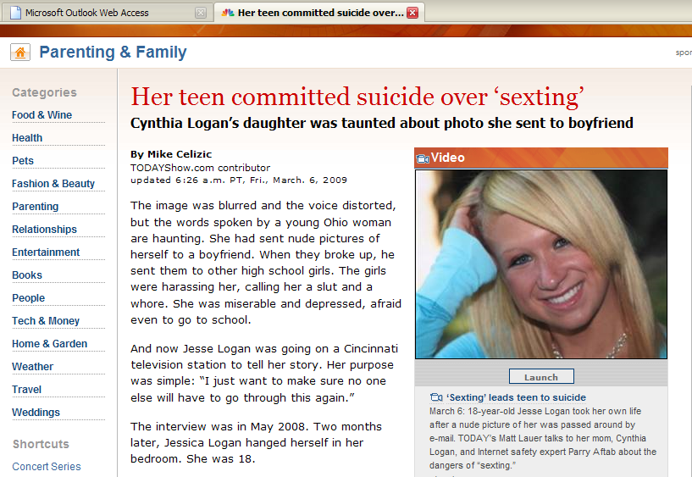

Slide 33
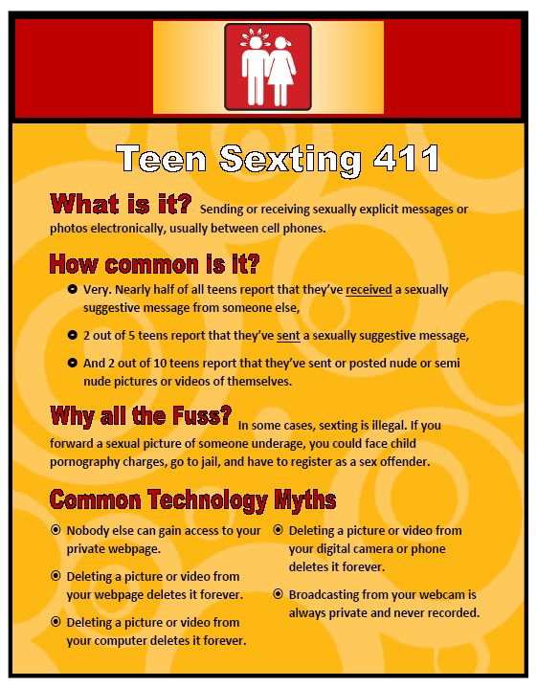
Notes:
Visit www.NetSmartz.org

Slide 34

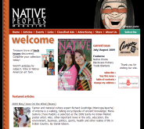

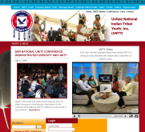
Tips for Parents
Talk with your kids about what they are doing online or with their cell phone.
Try your best to limit unmonitored technology use, and try to know who your kids are communicating with.
Place computers with internet access in a common room in the home.
Set limits on when and where technologies can be used.
Be aware of what your kids are posting online. Do they have a My Space or Facebook account? If so, ask to see their page.
SexTech & the Institute for Responsible Online and Cell Phone Communication
Notes:
Institute for Responsible Online and Cell Phone Communication: http://www.iroc2.org/page/parents-educators
SexTech:
Talk to your kids about what they are doing in cyberspace. Make sure your kids fully understand that messages or pictures they send over the Internet or their cell phones are not truly private or anonymous. It’s essential that your kids grasp the potential short-term and long-term consequences of their actions.
Know who your kids are communicating with online and on the phone. Supervising and monitoring your kids’ whereabouts in real life and in cyberspace doesn’t make you a nag; it’s just part of your job as a parent. many young people consider someone a “friend” even if they’ve only met online.
Consider limitations on electronic communication. The days of having to talk on the phone in the kitchen in front of the whole family are long gone, but you can still limit the time your kids spend online and on the phone. Consider, for example, telling your teen to leave the phone on the kitchen counter when they’re at home and to take the laptop out of their bedroom before they go to bed, so they won’t be tempted to log on or talk to friends at 2a.m.
Be aware of what your teens are posting publicly. Check out your teen’s myspace, facebook and other public online profiles from time to time. this isn’t snooping—this is information your kids are making public. If everyone else can look at it, why can’t you? talk with them specifically about their own notions of what is public and what is private. Your views may differ but you won’t know until you ask, listen, and discuss.
Set expectations. make sure you are clear with your teen about what you consider appropriate “electronic” behavior. Just as certain clothing is probably off-limits or certain language unacceptable in your house, make sure you let your kids know what is and is not allowed online either. and give reminders of those expectations from time to time. It doesn’t mean you don’t trust your kids, it just reinforces that you care about them enough to be paying attention.

Slide 35
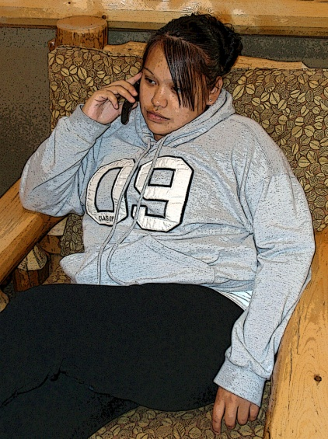
Tips for Educators
Talk candidly and openly with students about what they are doing online or with their cell phones.
Limit unmonitored technology use.
Prohibit cell phones in the classroom, and talk to your IT administrator about filtering websites on school computers.
SexTech & the Institute for Responsible Online and Cell Phone Communication
Notes:
Institute for Responsible Online and Cell Phone Communication: http://www.iroc2.org/page/parents-educators
Now is not the time to be coy, shy, timid, or indirect with your kids and students. Every time they use Digital Technology, they open themselves up to the world, and the risks that we all inherit once we power up!

Slide 36

Youth Videos…
Healthy Relationships (4:15 min.)
Teen Sexual Health
Condom Demonstration
Teen Pregnancy and Parenting
Role Play: Once is Enough (3:19 min.)
Role Play: This Can’t Happen to Me (4:46 min.)
Living with HIV/AIDS (16:57 min.)
Drugs & Alcohol (6:20 min.)
Three student-developed Public Service Announcements (PSA) (3:59 min.)

Slide 37
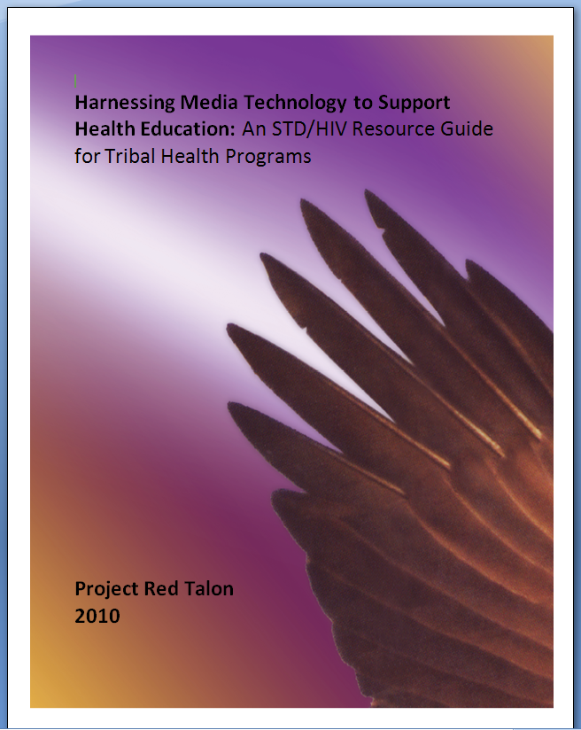

Slide 38
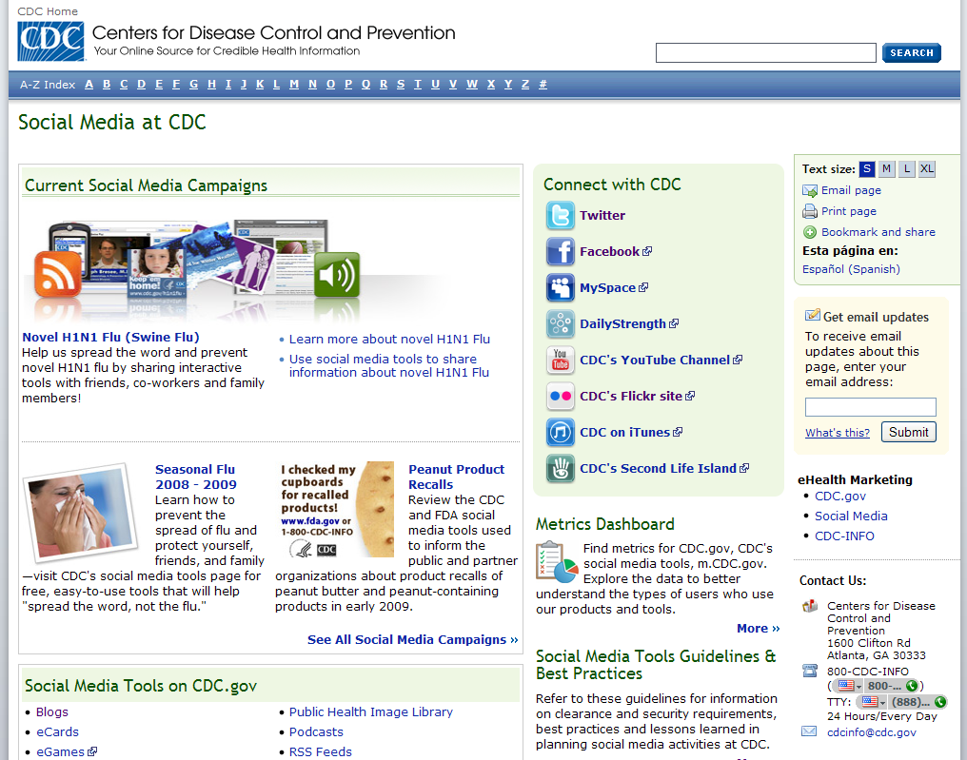

Social Media at CDC: www.cdc.gov/SocialMedia
CDC uses social media to disseminate credible, science-based health information. Visit their site to access:
Blogs
eCards
eGames
Email Updates
Mobile
Podcasts
RSS Feeds
CDC-TV
Widgets

Slide 39

Scarleteen: http://www.scarleteen.com
To ask Scarleteen a question, just text 66746 and start your question with the keyword: ASKST.
Questions about your body, birth control, sexually transmitted infections, your relationships, gender identity or sexual identity, your rights as a young person.
Help finding a sexual health clinic, a rape or abuse crisis center or hotline, emergency contraception , or help with any kind of harassment or bullying.
For helping out a friend.

Slide 40

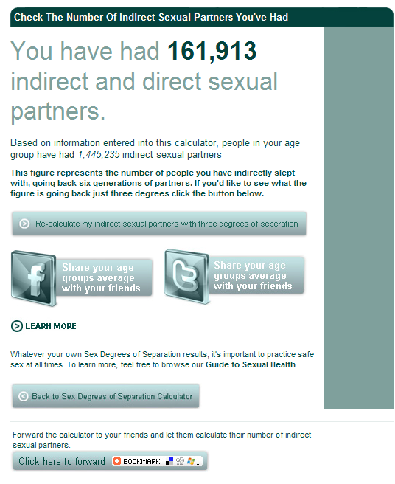
Sex Degrees of Separation Calculator
http://calculators.lloydspharmacy.com/SexDegrees/

Slide 41

http://www.gettested.com.au

Slide 42
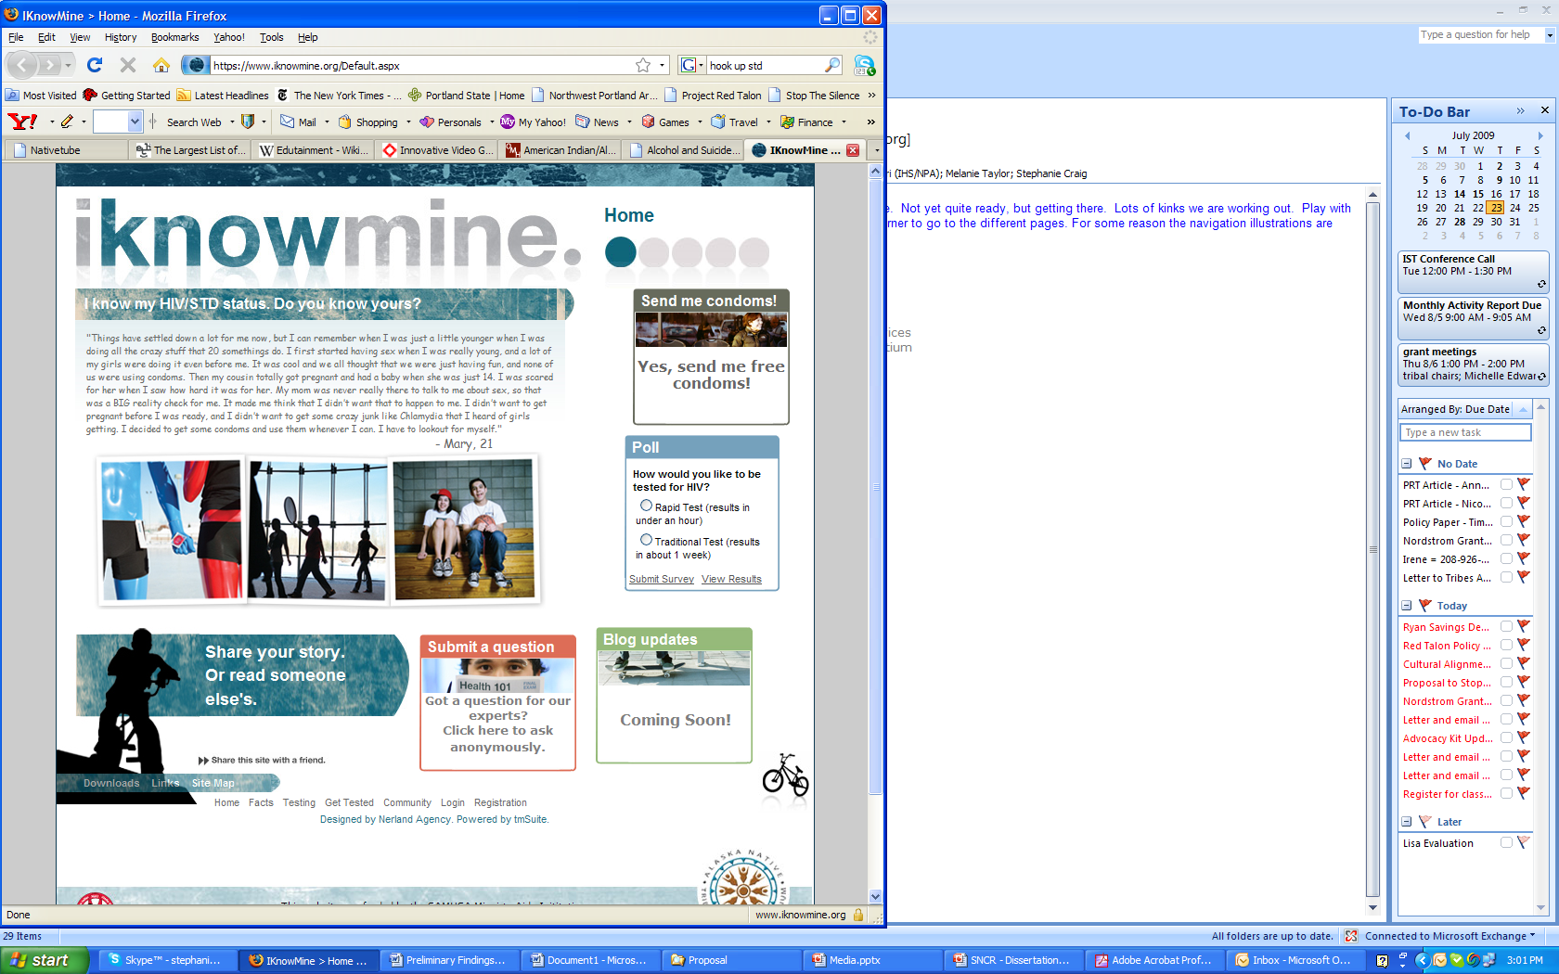

Slide 43
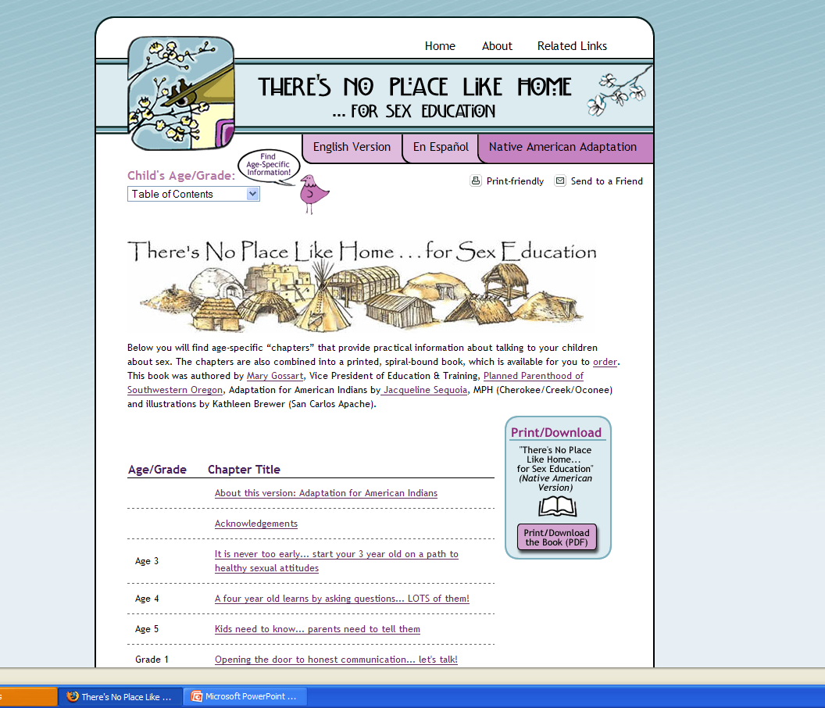

www.no placelike home.org/native american

Slide 44
Project Red Talon
What’s Next?

Slide 45


Slide 46
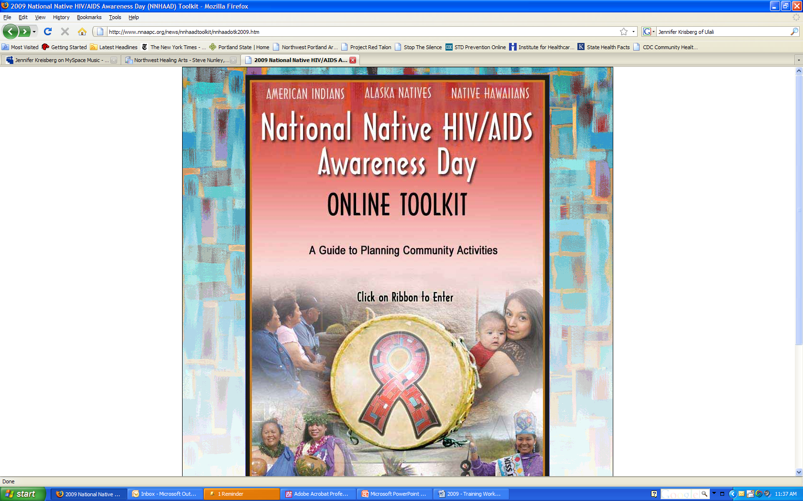
www.nnaapc.org

Slide 47


Slide 48


Slide 49


Slide 50

April – STD Awareness Month
www.cdcnpin.org/stdawareness

Slide 51
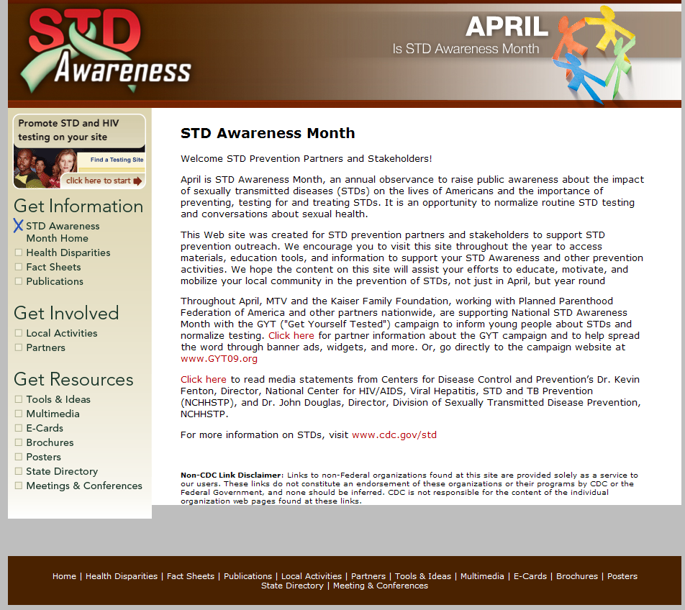

Slide 52
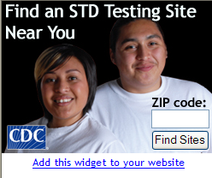
By the end of February…. http://www.cdcnpin.org/stdawareness/tools.htm

Slide 53

http://www.gytnow.org/

Slide 54



Slide 55



Slide 56


Slide 57
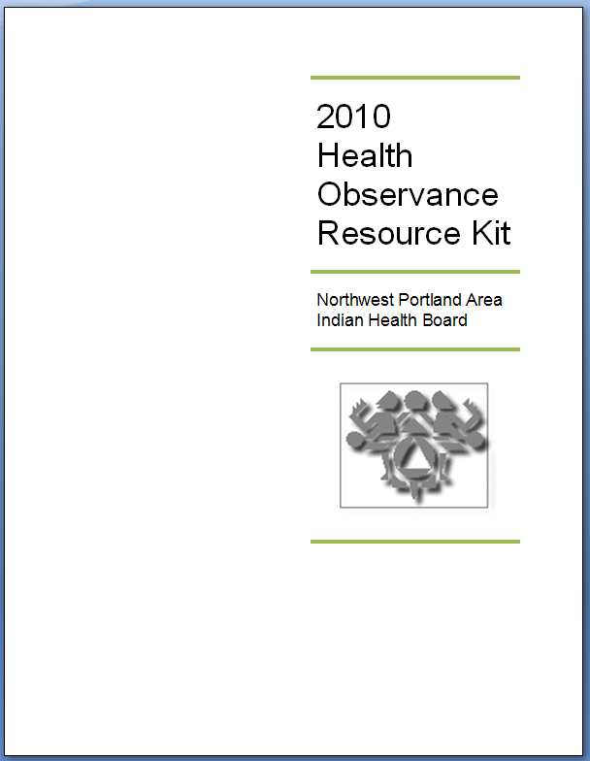
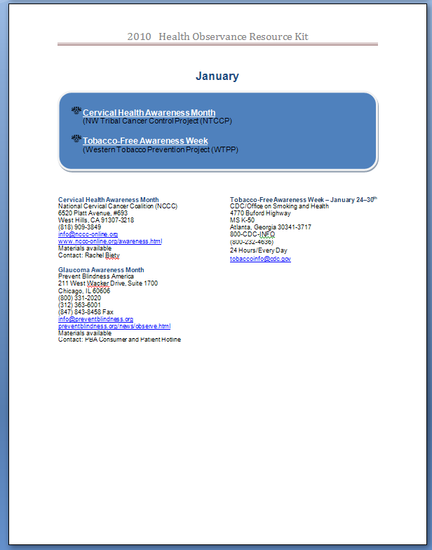

Slide 58
Contents
National website or contact links
2-3 ideas to engage community members around the Health Observance
A generic article about the observance that could be adapted or included in the tribal paper
Links/examples of available fact sheets, print/media materials, & other educational resources.
Any other idea you have?

Slide 59
Is this something that you would find useful?
Yes
No

Slide 60
What would be best for you?
Sections sent via email
Binder with tabs for each month
CD
On NPAIHB Website
Wall calendar

Slide 61
Questions?

Slide 62
Northwest Portland Area Indian Health Board
Stephanie Craig Rushing, MPH
Director – Project Red Talon
scraig@npaihb.org
Lisa Griggs
Administrative Assistant, Blackfeet
lgriggs@npaihb.org
NPAIHB: www.npaihb.org
PRT: http://www.npaihb.org/epicenter/
project/project_red_talon/
Stop the Silence: www.stopthesilence.org
Indian Leadership for Indian Health

